Slide 1

Q4 Webcast
Check Point ATC partners
31-October-2018
Toni Ponder | Manager: Training Programs, Certification

Slide 2
Agenda
Program Overview & Roadmaps:
  ATC Program: Stats, PMAP/ATC partner portal, training resale (Coop/CLC….)
  Courseware
    E-Kits ordering, access, features
      R77.30 End of Life
  Certification
New Offerings:
  Badges
  Spektra Solutions
  Cyber Range/Cyber Challenge

Slide 3
E-Kits /Regional Stats
Region | Q1 – Q3 2017 | Q1 – Q3 2018 | % Change
APAC | 576 | 971 | 69%
EMEA | 2,091 | 3,069 | 47%
LATAM | 502 | 530 | 6%
North America | 1,464 | 1,123 | -23%
Total | 4,633 | 5,693 | 23%

Slide 4

ATC Program
  Operations
    Contract Overview
      Course scheduling
      Quarterly training quota
    PMAP – 1 Stop
      ATC Partner Portal = order e-kits, marketing resources, instructor tools, enablement tools
      Zero dollar $ order form = student registration via Check Point websites
  Training Sales
    Customer registration type
      CLC – (CLC) customer redeeming learning credits for training course
      Promotions -
        (Net-New customer) - new customer promotion
        (Customer reference) - training vouchers for customers who refer check point publicly.
        (Selected Growth Partner) - training vouchers for partners who are part of Check Point global selected growth program

Slide 5

CLC Sales Overview:
ATC Selling, product catalog,
Training portal

Slide 6
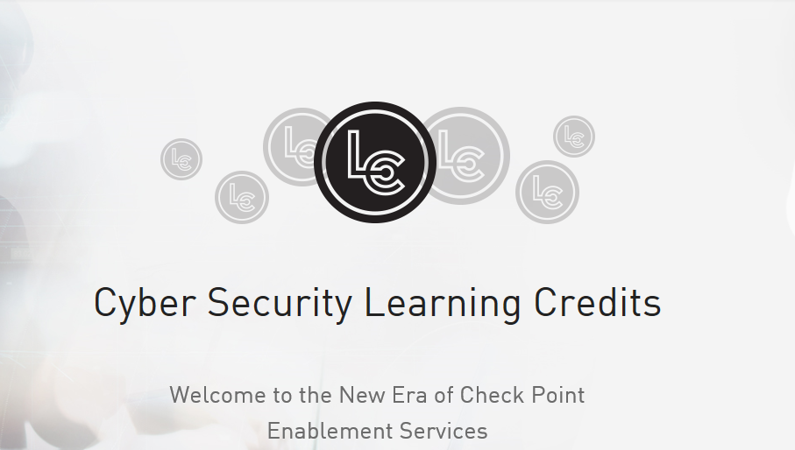
New CLC Landing Page
https://www.checkpoint.com/clc/

Slide 7

Buying CLCs
Yes, ATCs may purchase CLCs for your customers
  Special purchase path now Available to ATC partner
  CLC packs are available to ATC partners at the ATC order form in the ATC partner portal.
    Note - User Center account number needed to complete order for CLC packs.
  Starting point - 1 CLC = $100 USD; CLC rate for courses = 3,250 - 5,000 CLCs range
    Packs are available
    Discount rate for large volume
      Up to 500 CLCs – 30% discount
      501-999 CLCs – 35% discount
      >1000 CLCs – 39% discount
        Approved NSP for CLCs purchased at ATC order form
          NSP #1677683 – enter on order form in Additional Comments field

Slide 8
Implementation & Operations
Coop
Cyber-Security Learning Credits (CLC)
Training Promotions
    @ ATC partner perspective
      What, why, how to participate, when

Slide 9
Coop, Net-New Customer Promotions, CLC
ATC Partner Operations…..
  ATC partner must enroll to this Add-On program offer.
    ATC partner post courses for Check Point to resale; Check Point will pay ATC partner for students that register via these paths
  Coop Dashboard = channel partner training AND customer promotions AND CLC training delivery tool
    All student registrations must be completed at Coop or CLC dashboard
      ATC to complete monthly report and invoicing for these promotions
  ATCs upload and manage course listing at this site
  Daily payment rate per contract amendment

Slide 10
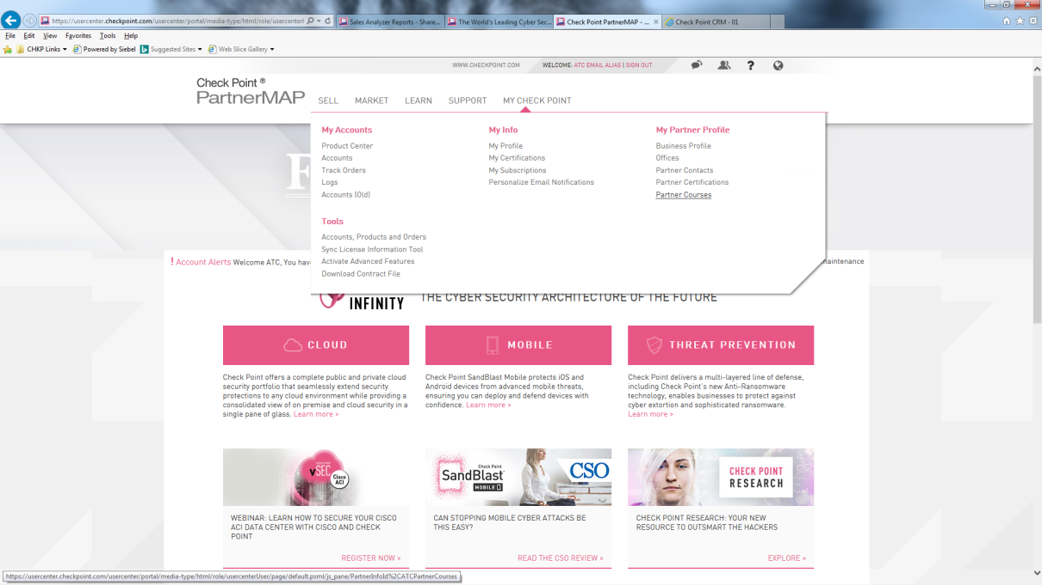
After ATC is Enrolled to Deliver Courses….
1st - How to Post Training Courses in PMAP

Slide 11
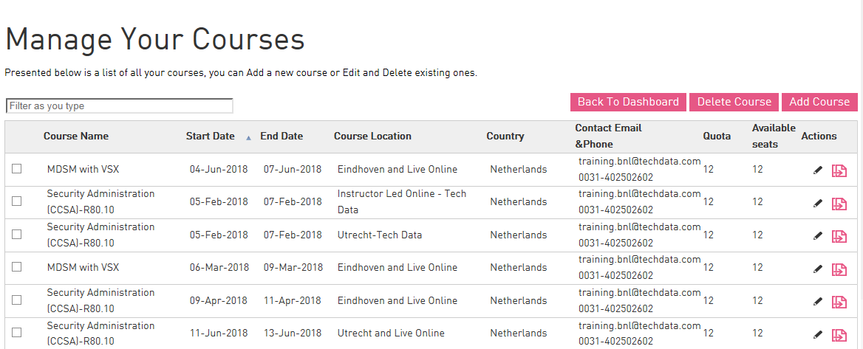
After ATC is Enrolled to Deliver Courses….
1st - How to Post Training Courses in PMAP

Slide 12
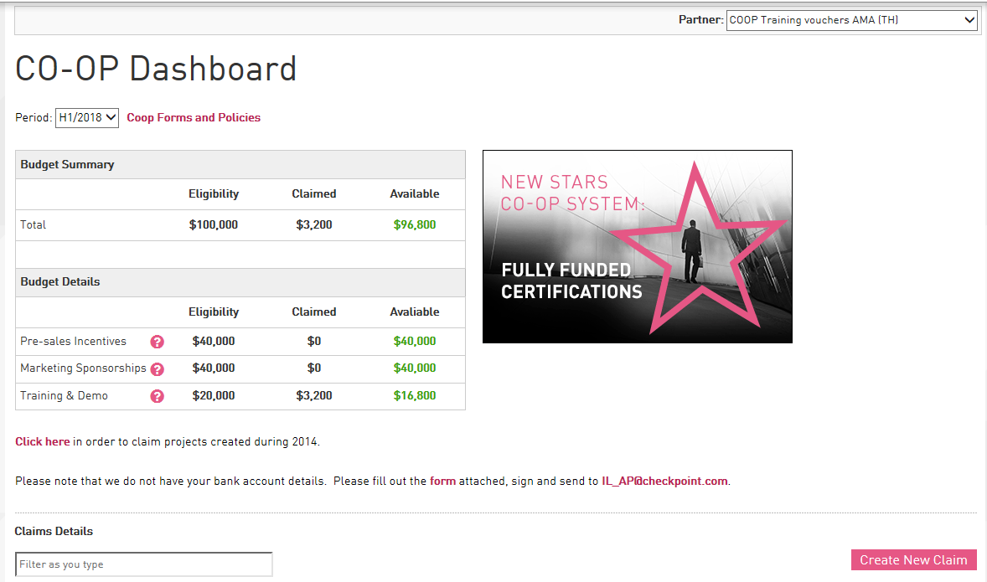
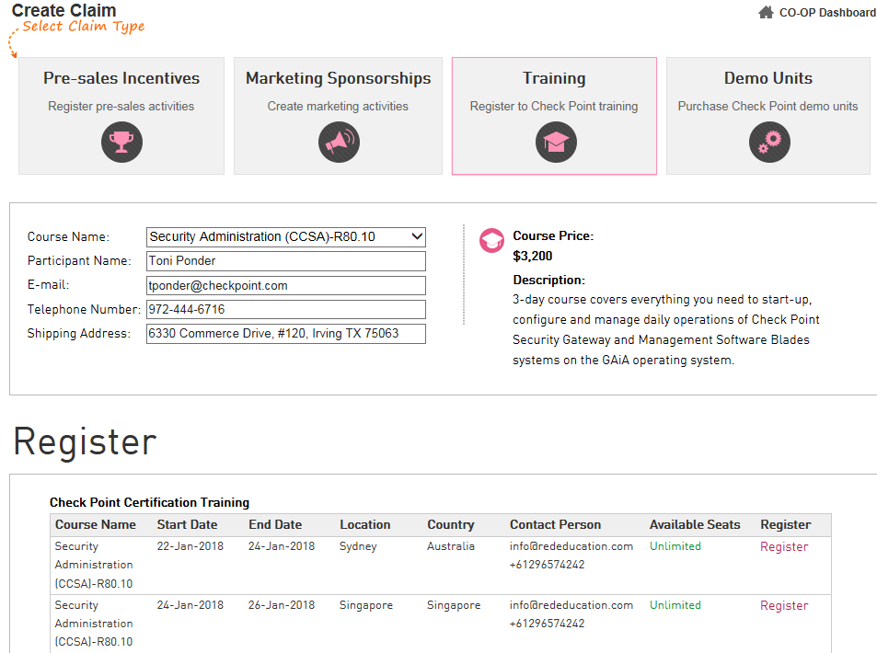
Coop Dashboard

Slide 13
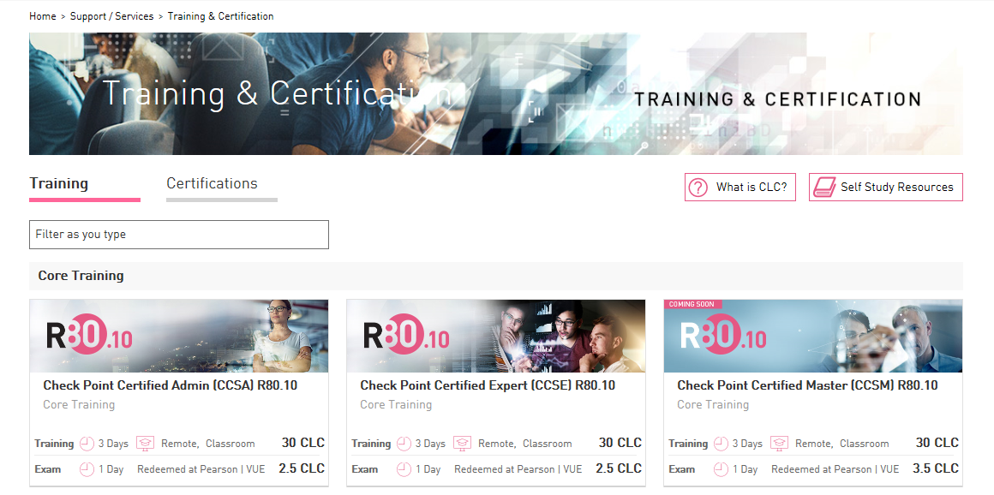
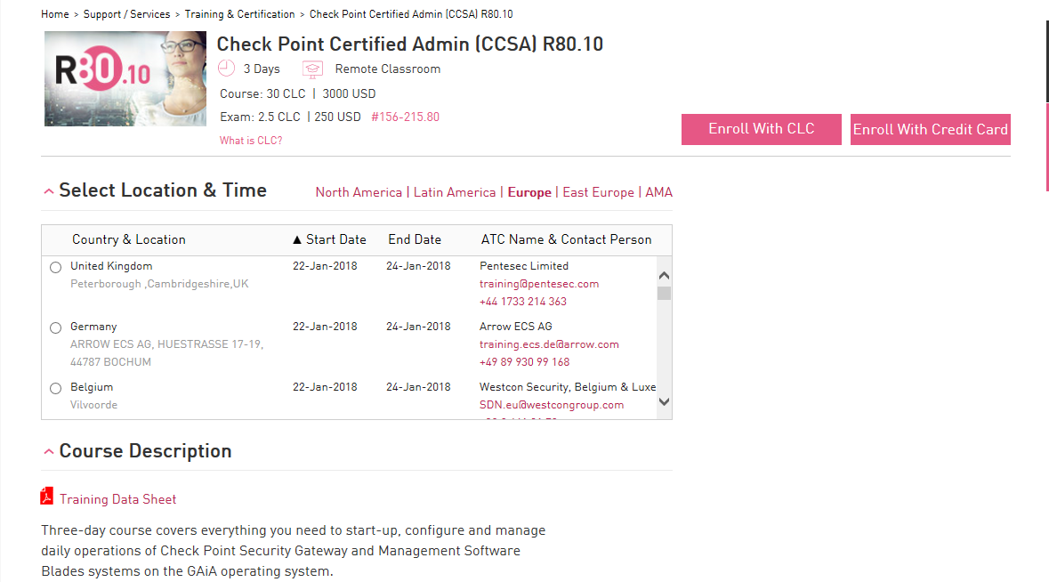
CLC Portal, Dashboard
https://store.checkpoint.com/training-certification/

Slide 14
Knowledge is Power
ATC Partner email distribution list
  We manage our program email list.
  Add/remove your key team members
    Contact atc@checkpoint.com for assistance
This list is used only for ATC partner program updates

Slide 15
2018-2019 Program Events
ATC Webcasts:
  Q4: 31-Oct
2019:
  Q1 Webcast - January
  CPX
  2019 – 1st ATC Summit – May/June.
    Locations TBD

Slide 16

Courseware Development Roadmap

Slide 17

Courseware Roadmap
Q3
  CCSM version 2
Q4
  Endpoint Specialist (CCES)
  Cloud Specialist (CCCS)
Q1
  Multi-Domain Specialist (CCMS)
  VSX Specialist (CCVS)
  Technical Specialist (CCTS)
  Begin work on R80.20 Core Course Releases

Slide 18
Summary
New Specialist Courses on the Horizon
  Provides new bundling options
  Emerging Technologies
  Instructor Utilization
  The planned names of these courses may change
  The Endpoint course, will include SandBlast technologies
R80.20 CCSA/E/M
  Expect course development to begin later in Q4 with releases planned to begin in 2019.

Slide 19
R77.30 …..
What’s on your training calendar?
Slowing demand
* Remove from e-kit order form @ EOY
** Certification Exams EOL @ end of Q1

Slide 20
Contact
courseware@checkpoint.com

Slide 21
E-kit delivery

Slide 22
E-Kits
E-kit orders are placed at ATC partner portal
  Ordering courseware
    Order form
    Enter student’s email address
      Must have Check Point User Center account
    Calculating the courseware order $ total
  Confirming your order has been received at Check Point
  Final step in e-kit order confirmation
  ATC partner to contact student with e-kit links

Slide 23
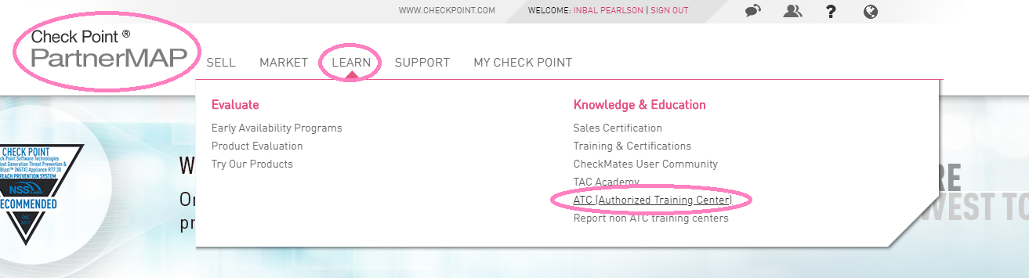
Order Form @ ATC Partner Portal
Log in to your PartnerMap account → Learn → ATC (Authorized Training Center)

Slide 24
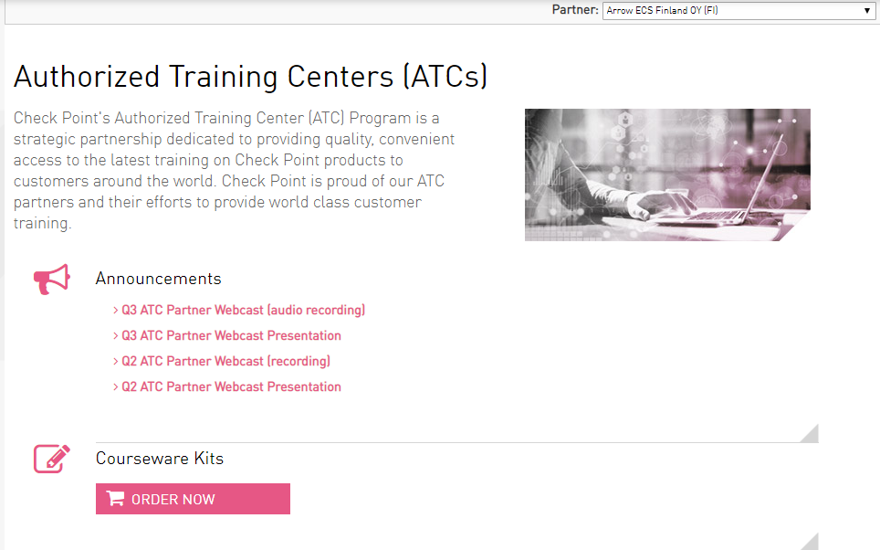
Order Form

Slide 25
Verifying Individual Email Address @ User Center
To create or confirm if a student has a profile, perform the following actions.
Log into the User Center at https://usercenter.checkpoint.com/usercenter/index.jsp
Click the “Sign Up Now” button
Complete all required fields (marked with an asterisk)
Click the "Submit" button
  If the student has an account/profile created, you will receive a message that the user already exists.
  Otherwise, a profile will be created to allow you to place the courseware order.

Slide 26
New Capsule Docs Program
New Viewer w/ Enhancements
http://atc.checkpoint.com/ebooks/Viewer/CPDS-Viewer.zip
  CPDS-Viewer.zip contains the following items:
    CPDS.exe
    CPDS-FAQ.pdf
    CPDS-Installations-Instructions.pdf
  Launch date: Mid-July
Print Functionality w/ Adobe DE Version 2018; 2019 = still on hold

Slide 27
Summary
Email address verification process @ time of order, instead of at course start
Student is to test e-kit before course starts
Confirm student info and order details as 1st step in resolution
Troubleshooting tips in Addendum

Slide 28
certification

Slide 29

Certification
Certification exams are delivered by PearsonVUE Testing Centers
R80.X Exams = CCSA, CCSE, CCSM, CCAS
Roadmap = Endpoint (CCES), Revise CCSA exam, Specialist course exams

Slide 30

Certification Promotions
Spring 2018
  CP15 – 15% discount on R80 CCSE and SandBlast
  CP20 – 20% discount on CCSPA
Summer 2018
  Core20 – 20 % of all Proctored exams
  Practice50 – 50% off Practice exams
Q4 Promos
  Black Friday/Cyber Monday
+ any new exam release

Slide 31
Contact
Jason Tugwell, Certification Manager
certification@checkpoint.com
accountservices@checkpoint.com

Slide 32
2019 Course Catalog
Certification model

Slide 33









Innovating for the Future
CCAS
CCSA & CCSE = 2 Year Cert
Specialist = 1 Year Extension
2 Core Certs + 3 Specialist Certs = Security Master
Check Point Automation Specialist
2-Day Course/1-Year Extension
CCVS
Check Point Virtualization Specialist
2-Day Course/1-Year Extension
CCMS
CCSA
CCSE
Check Point Management Specialist
2-Day Course/1-Year Extension
CCSM
Check Point Security Administrator
3-Day Course/2-Year Cert
Check Point Security Expert
3-Day Course/2-Year Cert
CCES
Check Point Security Master
5-Year Cert
Check Point Endpoint Specialist
2-Day Course/1-Year Extension
CCCS
Check Point Cloud Specialist
2-Day Course/1-Year Extension
CCTS
Check Point Technical Specialist
2-Day Course/1-Year Extension

Slide 34
Comparative Analysis
Current Path:
  CCSA + CCSE + CCSM = Master Cert
  $2450 (Max Profit per Student/4 years)
  Lack of full instructor utilization for ATCs
  Encourages Bootcamp Bundle
  1-Day Workshops
    Product specific sales training
    Disparate environments, challenging to deliver
  Discourages CCSM course participation
    No need to take the course to pass the exam.
    Only one exam required for CCSM
    No real benefits of CCSM
Proposed Path:
  CCSA + CCSE + 3 Specialist Certs = Master Cert
  $3350 (Max Profit per Student/5 years)
  Full instructor utilization for ATCs
  Discourages Bootcamp Bundle
  Offers Student Customization
  Allows for Solutions Training
  Fully Integrated Classroom Environments
  Encourages additional course participation
    Multiple Exams Required for Master Certification
    Specialized Path to Match Customer Deployments
    Gives More Gravity to Master Certification

Slide 35
New offerings

Slide 36
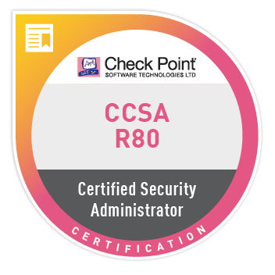
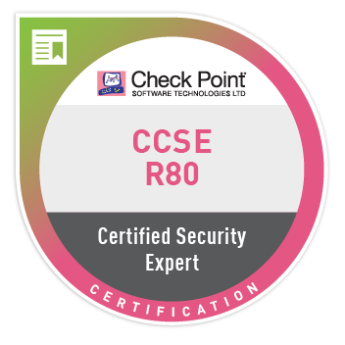
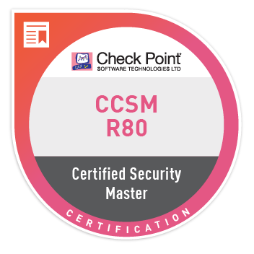
Badge Samples

Slide 37
CCSA Cloud Labs in the Azure Cloud
Check Point is working with Spektra Systems to provide the lab environment for CCSA course in the Azure cloud
Spektra management portal lets you create and provision a separate Azure account for each student with the necessary VMs for the lab
Contact Amit Malik (amit@spektrasystems.com) for questions about purchasing labs
Estimated cost $100 USD per student for 3 day access to cloud lab
  $3 USD Hourly cost (minimum 20 hours)
  Maximum cost $150 USD for 36 hours
  Course trainer is able to shut down the student lab environments
Joint webinar with Spektra Tuesday Nov. 6 to explain all the details!
Education Services point of contact is Yaakov Simon

Slide 38

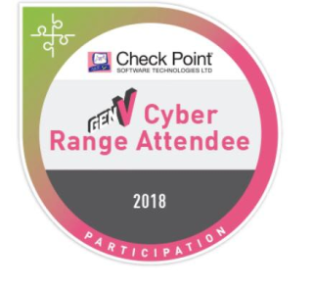

Gamification – Cyber Range/ Cyber Challenge.
Sharpen your hacking skills and enhance your cybersecurity knowledge with hands-on gamified training. Train in a relevant, engaging and safe simulated environment while solving real-life problems.
Live page to be launched with all relevant info and dates by Nov 15th.
Multiple levels and Badges for each accomplished challenge

Slide 39
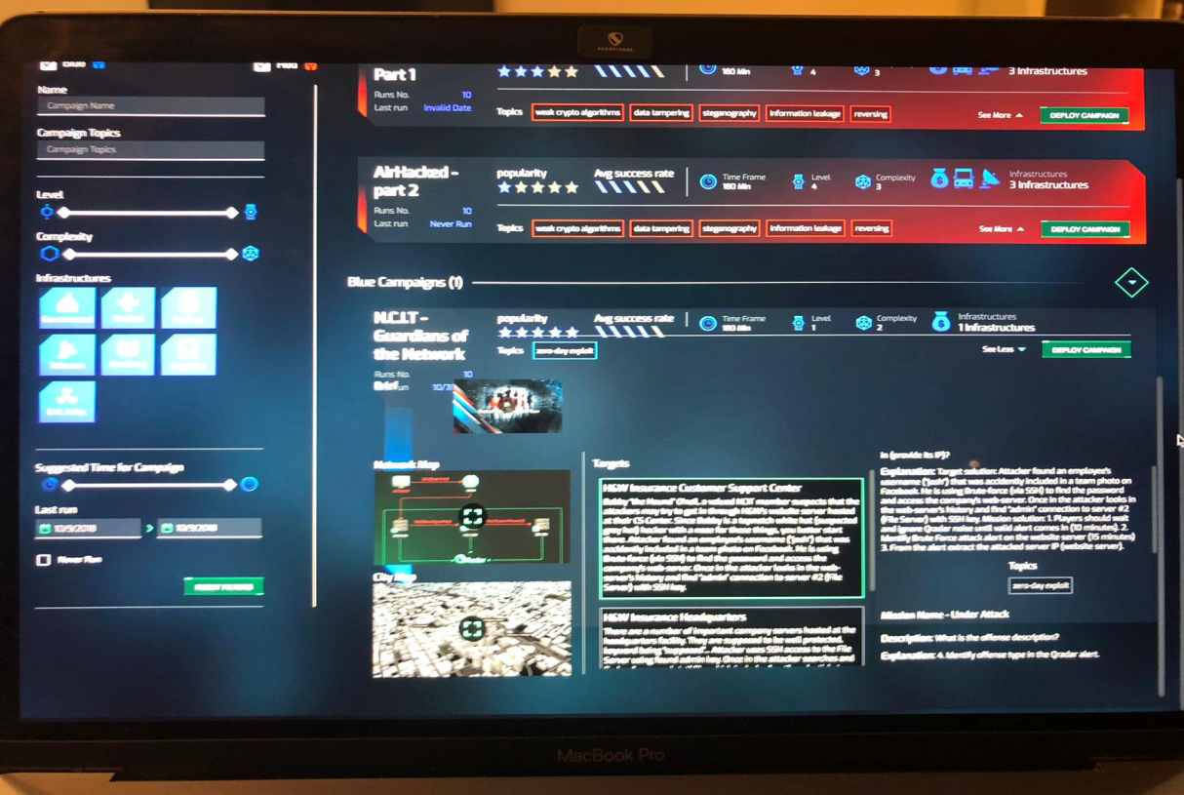
Gamification – Cyber Range/ Cyber Challenge.
Blue Vs Red Cyber challenge, demonstrating GenV defense capabilities.
Offer can be prices and tailored user based or team based.
Pricing:
Individual half day – 5CLC’s (Price List)
Above 10 participants – receive 2 free passes.

Slide 40
Contact Information
ATC Program
HackingPoint
tponder@checkpoint.com
atc@checkpoint.com
Hackingpoint@checkpoint.com
Certification
Courseware
jtugwell@checkpoint.com
accountservices@checkpoint.com
certification@checkpoint.com
courseware@checkpoint.com

